Slide 1
IBM Journey to Cloud and A.I.
Analytics Modernization Workshop (v9.0)
Featuring Cloud Pak for Data (v3.0.1)
Overview
Burt Vialpando – IBM
October 28, 2020

Slide 2
Cloud Pak for Data Workshop Highlights
Small demo cluster configuration
Allows each student to have their own cluster
Supports workshops of up to 10 students
Easily deployed in Skytap
Unified Desktop environment image
Launch the CPD console, cluster terminal window, OpenShift console, etc. from one desktop UI
Modular lab design
Any lab can be run independently from the others
Facilitates an easy demo environment
A driving presentation deck
Presentation deck used to drive the workshop flow and CPD messaging – tailored to the labs
Persona focus
Workshop labs focus on each persona as they flow through the Admin, Collect, Organize, Analyze, Deploy and Infuse steps in the journey to AI
Churn use-case narrative
A customer churn use-case is used throughout as the narrative for why and how an application can be infused with a machine learning model
Detailed Getting Started Guide
How-to on starting the cluster and driving the workshop from a technical perspective
How to Host Guide
Everything you need to know on hosting your own workshop.

Slide 3
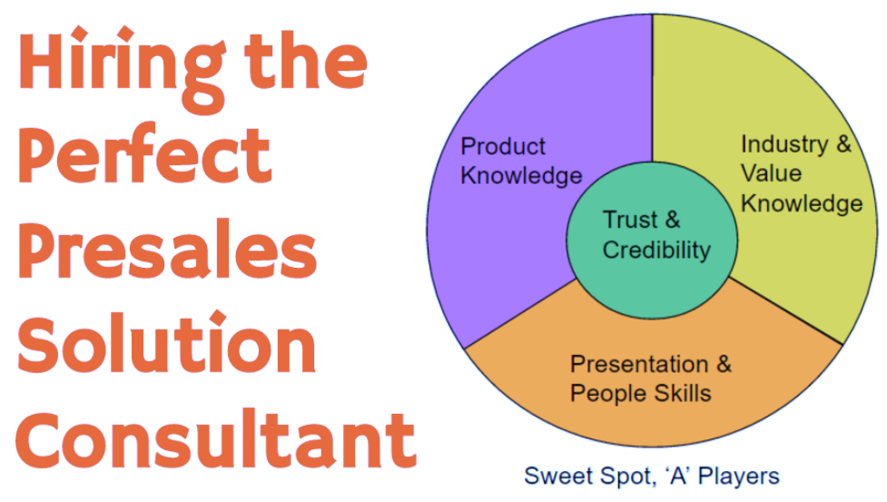
The “A” Players in Technical Presales

Slide 4
Technical Presales Asset Delivery Options This workshop asset can serve as a basis for most of them
Asset | Typical Time | Description
Presentation | 30 – 120 minutes | Presentation deck only. Could include a video clip or a URL link display. Key point: This is only talking - no technical work done by anyone.
Demo | 10 – 60 minutes | Easier ones can be done by a sales rep (especially ones that have been pre-recorded and simply played back) but most often a technical specialist or architect will do these. This is especially true of the more complex ones. (Which can include a presentation.) Key point: the IBMer is the one doing the hands-on “driving” not the client.
Proof of Technology (PoT) | 1 – 3 hours | These are pre-setup events that the potential client can do by themselves virtually. This lends to engagements launched from an IBM site like DTE (Digital Technical Engagement) or bluedemos.com. Key point: the client runs these as hands-on exercises, but are usually limited in scope and do not require an IBMer to present.
Hands-on Workshop | 1 – 3 days | These are pre-setup events like a PoT, but are much deeper technically. Key point: these are run by technical IBMers who present the material first before the client does the hands-on lab exercises. Often lecture/lab, lecture/lab format.
Proof of Concept (PoC) / MVP | Many days, weeks, or even months | These are technical engagement run on a clients hardware with clients data, or borrowed IBM hardware with clients data. Key point: these require many days of preparation, with a Document of Understanding between parties, specific goals outlined, etc. All are unique to a customer’s use case.

Slide 5
How the CPD workshop is being used in the field
As a workshop
Either a 1-day platform overview, or a 2 or 3-day technical deep dive / bootcamp
Either as pre-sales to drive the sales cycle, or as post-sales to ensure implementation and use
Either in DTE 2.0 (Skytap) via DTE/CSIDE or in the HCCX ESX servers for special North America engagements
Either as a face-to-face (on premises) event or as a virtual event using WebEx Training (social distancing solution)
Very repeatable (works every time with no setup) and scalable (hundreds can use it concurrently)
Copied and leveraged by various places, e.g. Europe’s (EMEA) TEC / ICC-VE
Used for workshops outside NA (not performed from Skytap) and as a platform for PoCs.
Demos
Many CTPs use it as their CPD demo system (due to its modular design)
Many CTPs add their own artifacts and customizations to it (due to it having web client admin and OS root access)
Internal enablement or training
Hundreds of IBMers around the world have used it to learn about CPD, or to brush up on its latest features
(e.g. 70+ Summit hires are presently going through Technical Selling training using this workshop as its basis)
Business Partner enablement or training
HCCX sales motion
Plans are being made to use it as a “Day 1” for the HCCX, then as a platform for “Day 2” PoC / MVP kickoff

Slide 6
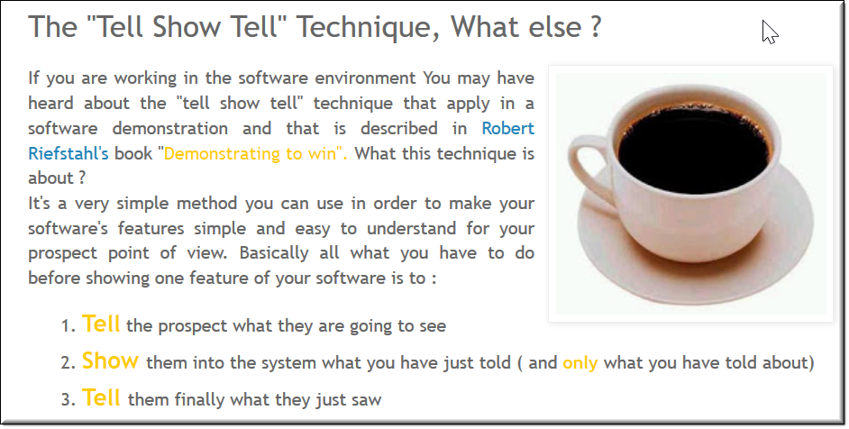
Hands-on Workshop Structure Tell-Show-Tell: the “Demonstrating to win” technique
The IBM workshop format is: lecture-lab-recap, lecture-lab-recap, lecture-lab-recap
The IBMer lectures on the topic (Tell)
The client does the lab exercises (Show)
The IBMer recaps the topic and the lab (Tell) before moving to the next topic

Slide 7
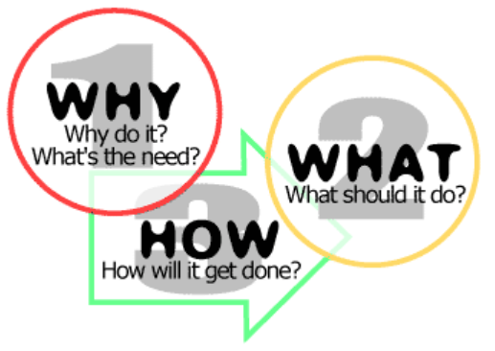
Hands-on Workshop Structure Why-What-How – the proven sales and marketing approach
Why
The presentation should always lead with a “WHY”
WHY are the clients here? WHY should they care about the topic? WHY is the specific product being presented? WHY should the attendees buy IBM solutions?
What
The presentation should tell WHAT the IBM solution is (at a macro level)
…and WHAT the particulars are about the technology (at a micro level)
How
The labs should show HOW the solution works
…and HOW the solution applies to a particular use case or various use cases.

Slide 8
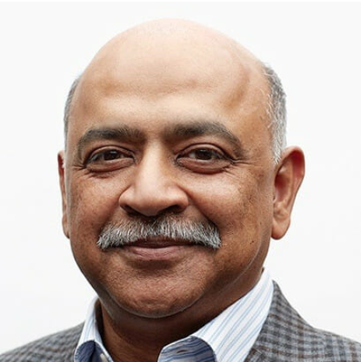
Cloud Pak for Data Workshop
Built for “Touch and Feel, Experiential selling”
"We have to change how we show up to clients... More experiential, more touch and feel, less talking at them.... They can actually talk to you by experiencing what you do."
Arvind Krisha, IBM CEO
May 11, 2020 During his fireside chat with Bridget van Kralingen, Senior Vice President, Global Markets

Slide 9
Cloud Pak for Data Workshop
Built for “Great Storytelling”
"Storytelling is the greatest technology that humans ever created"
Rob Thomas, Senior Vice President, Cloud & Data Platform
THINK 2020 keynote address
Rob actually repeated this statement, saying it twice to emphasize the importance and need for good storytelling in our business engagements.
9

Slide 10
Cloud Pak for Data Aligns closely with the IBM Foundational Strategy
Clients
CPD workshop is a client engagement with experiential client focus
CPD solution is built for enterprises
CPD is itself an integrated platform
CPD has all the tool for creating end-to-end AI / Cognitive solutions
CPD is built on Private cloud native architecture
Enterprise Out (B2B)
Integrated Value
AI / Cognitive
Cloud
Security & Trust
10

Slide 11
Cloud Pak for Data Workshop Cluster Image Delivery Mechanism
Hybrid Cloud Cognitive eXploration centers
(HCCX)
IBM DTE 2.0
World-Wide support
SoftLayer
HCCX ESX Servers
DTE Skytap Account
Workshops are conducted from here
Dev cluster
x
x
Customer clone
Customer clone
x
Cloned Template
Customer clone
Customer clone
x
Cloned clusters
Customer clone
Customer clone
Workshops are conducted from here
ICC-VE
(EMEA servers)
Workshops are conducted from here
Cloned Template
11
Notes:
This is the production process:
User develops the workshop on a set of VM images and takes a final snap shot of the finished product. On the ESX server, a virtual router is used for internet access.
HCCX architect clones the snap shot images by exporting the VMs as ova files.
HCCX architect creates a template from the cloned ova files and configures the networking on it to work on Skytap. Needs to make subnet changes different from the ESX Server so that copies will always work in a NAT environment and internet access will always be available. No port mapping is done.
HCCX architect creates two clones from that. If all goes well with testing, that tested image is discarded and the second one is used for the final template to move to Blue Demos
A BDAT form to publish to Blue Demos is filled out.
DTE architect then moves the final template to the Blue Demos location to be cloned repeatedly for all future workshop engagements. The DTE Skytap (IBM Blue Demos) Account is where the bulk of the workshops and self enablement are done from.
HCCX can run workshops from their own clones as well.
ICCVE runs workshops and even PoCs from clones.

Slide 12
Cloud Pak for Data Workshop Cluster Configuration (V9.0)
NODE | FUNCTION | INTERNAL IP | CPU (CORES) | RAM (IN GB) | DISK (IN GB)
1 | Master 1 | 192.168.142.71 | 16 | 64 | 200 OS 1,750 NFS
2 | Worker 1 | 192.168.142.72 | 24 | 80 | 200 OS 500 PX
3 | Worker 2 | 192.168.142.73 | 24 | 80 | 200 OS 500 PX
4 | Worker 3 | 192.168.142.74 | 24 | 80 | 200 OS 500 PX
5 | Worker 4 | 192.168.142.75 | 24 | 80 | 200 OS
6 | Worker 5 | 192.168.142.76 | 24 | 80 | 200 OS
7 | Worker 6 | 192.168.142.77 | 24 | 80 | 200 OS
8 | Worker 7 | 192.168.142.78 | 24 | 80 | 200 OS
9 | Worker 8 | 192.168.142.79 | 24 | 80 | 200 OS
10 | NPS | 192.168.142.80 | 4 | 16 | 200 OS
 | TOTAL |  | 212 | 720 | 5,250
CPD CLUSTER
12

Slide 13
Cloud Pak for Data Workshop
V9.0 Core labs
Lab | Comment | Service(s) used
01 - Getting Started | Updated | CPD Lite (Control Plane), OpenShift, Metrics Server
02 - Business Use Case |  | Cognos Dashboard Embedded
03 - Collect Connections |  | Db2 Advanced Edition, MongoDB
04 - Organize |  | Watson Knowledge Catalog, Data Stage Edition, Watson Studio (Local), Db2 Advanced Edition
05 - Collect: Data Virtualization | Updated | Data Virtualization, Db2 Advanced Edition, MongoDB
06 - Analyze: AutoAI and Notebook | Updated | Watson Studio (Local), Watson Machine Learning
07 - Deploy |  | Watson Machine Learning
08 - Infuse: OpenScale | Updated | Watson OpenScale, Watson Machine Learning
09 - Infuse: Cognos Analytics | Updated | Cognos Analytics
10 - Wrap up
13

Slide 14
Cloud Pak for Data Workshop
V9.0 Deeper Dive labs
Lab | Comment | Service(s) used
11 - Data Virtualization Caching | Updated | Data Virtualization, Db2 Warehouse on Cloud
12 - DV from a z/OS Source | All New | Data Virtualization, Db2 Warehouse on Cloud, DVM for z/OS
13 - Organize (Deeper Dive) | Updated | Watson Knowledge Catalog, Data Stage Edition, Watson Studio (Local), Db2 Advanced Edition
14 - Cognos Dashboard Embedded | Updated | Cognos Dashboard Embedded
15 - SPSS (using NPS) | All New | SPSS Modeler, NPS, Watson Machine Learning, Watson Studio (Local)
16 - Netezza Performance Server (NPS) | All New | Netezza Performance Server (VM sidecar)
14

Slide 15
Cloud Pak for Data Workshop
Assets
Presentation deck
This drives the overall workshop
Is the “TELL” of the WHY and WHAT
https://ibm.box.com/v/CPD-Workshop-Presentation-v9
Workbooks
Drives the lab exercises
Is the “SHOW” of the “HOW” things are accomplished
https://ibm.box.com/v/Workshop-Workbook-v9
Getting Started guide
Specific instructions to the technical IBMer on how to setup and run the workshop
https://ibm.box.com/v/Workshop-Getting-Started-v9
Flyer
Used by the sales reps and technical IBMers to drive attendance to the workshop
https://ibm.box.com/v/CPD-Workshop-Flyer-v9
15

Slide 16
Cloud Pak for Data Workshop
How to Host
How to Host a Workshop guide
This guide tells you everything you need to know to deliver a workshop.
https://ibm.box.com/v/CPD-Workshop-HowToHost-v9
DTE Skytap clusters
There are DTE Skytap VM cluster images available for customer workshops.
Note: Is also available for self-enablement to prepare for delivery of the workshop
ibm.biz/dte-cpd-workshop-v9
Tech specialists who are setting up the workshop and proctoring during should go through these labs as least two times to feel comfortable with them.
Workshop Box folder – All source here
https://ibm.box.com/v/CPD-Workshop-v9
16

Slide 17
Cloud Pak for Data Workshop
Delivery Team
Workshop Delivery:
Burt Vialpando Planning and design
Kent Rubin Workshop update lead
John Lucas Workbook publication, lab testing, email support, workshop support
Dan Kikuchi Workshop cluster install lead
Rich Russo Workshop VM creation, HCCX support lead
SMEs and contributors:
Data Virtualization (Collect) Rajesh Kartha
Organize John Lucas (backed up by John Van Buren)
Notebook (Analyze) Tom Konchan
OpenScale (Infuse) Eric Martins
Cognos Analytics (Infuse) Kent Rubin
SPSS Tom Konchan
NPS Daniel Hancock
z/OS David Trotter
Security Michael Schapira
17

Slide 18
Thank you!

